Slide 1
Computer Aided Diagnosis
Challenge 1
Muhammad Roshan Mughees | Jana Vujadinovic

Slide 2
Content
General Idea
Pipeline
Segmentation
Feature Extraction
Results
Conclusion

Slide 3
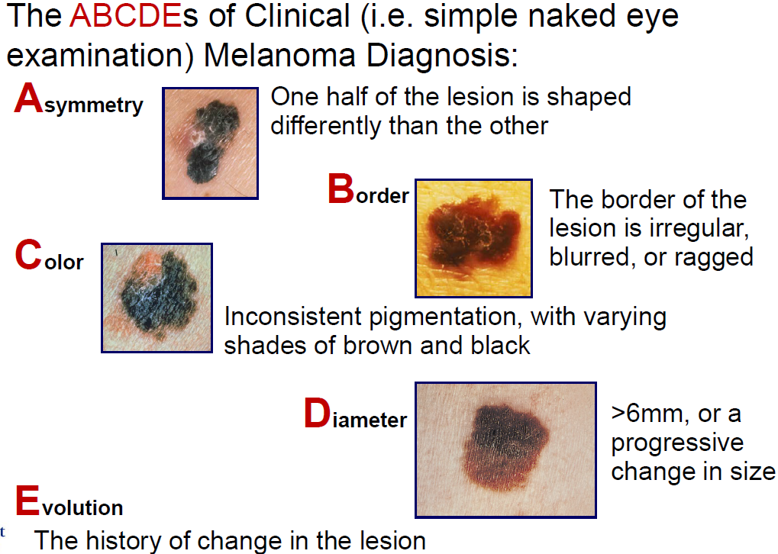
General Idea

Slide 4
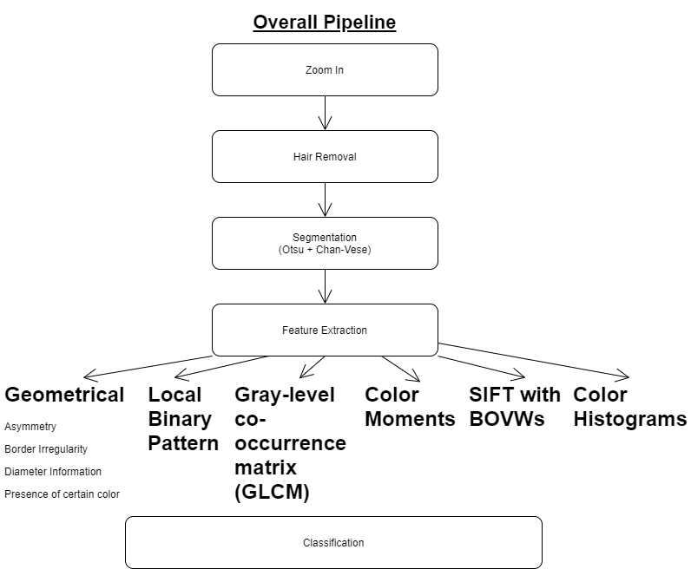
PIPELINE

Slide 5
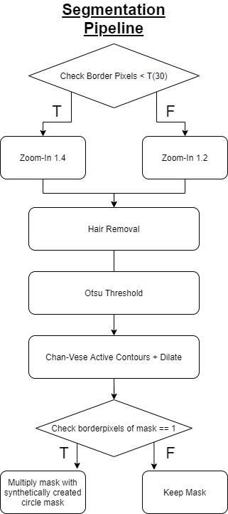
SEGMENTATION

Slide 6
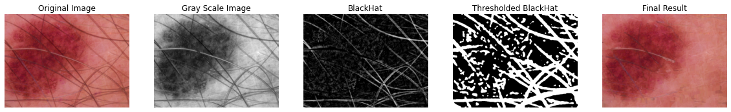
Hair Removal
Hair Removal Dull Razor Algorithm: https://github.com/sunnyshah2894/DigitalHairRemoval

Slide 7
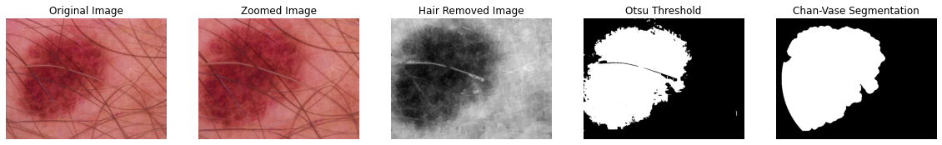
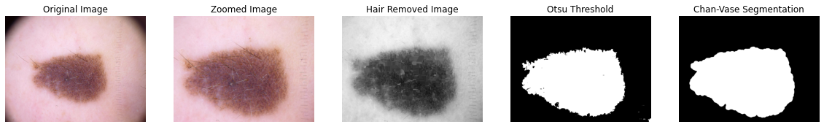
SEGMENTATION

Slide 8
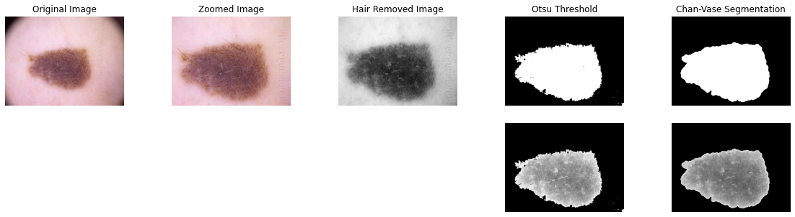
SEGMENTATION

Slide 9
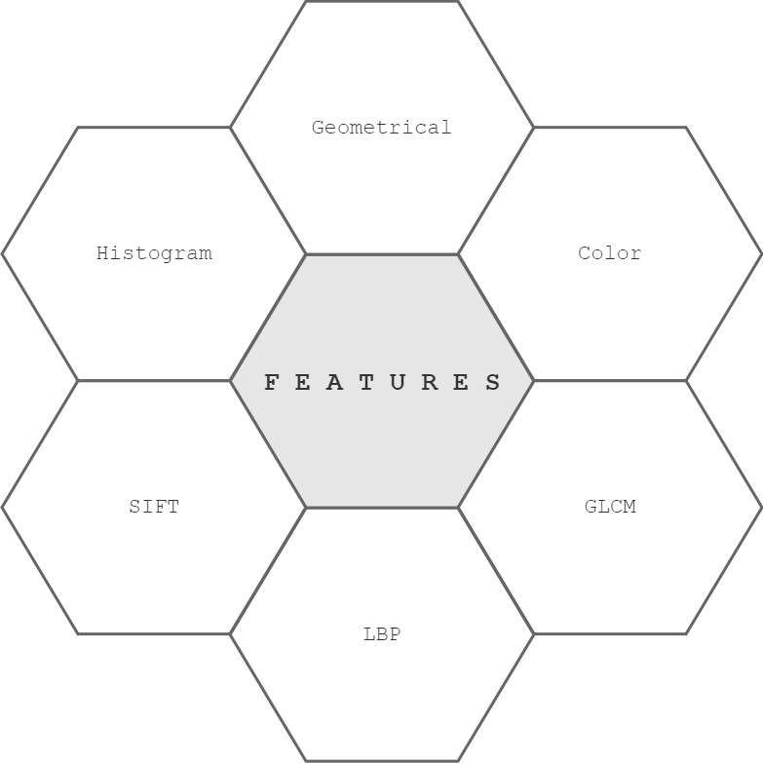
FEATURE EXTRACTION

Slide 10
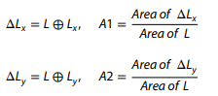
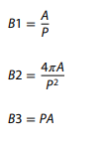
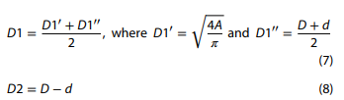
Geometrical Features
Asymmetry Information
Border Irregularity
Area to perimeter ratio
Compactness Index
Perimeter multiplied by Area
Diameter Information
Average Diameter of the lesion
Difference between principal axis length
The formulas mentioned in this presentation were taken from: Majumder, Sharmin, and Muhammad Ahsan Ullah. "Feature extraction from dermoscopy images for melanoma diagnosis." SN Applied Sciences 1.7 (2019): 1-11.

Slide 11
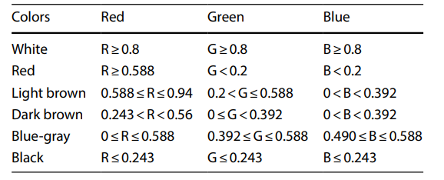
Color Information
Threshold values for different colors
Color Moments
Mean
Standard Deviation
Skewness
The threshold values for different colors were taken from: Majumder, Sharmin, and Muhammad Ahsan Ullah. "Feature extraction from dermoscopy images for melanoma diagnosis." SN Applied Sciences 1.7 (2019): 1-11.

Slide 12
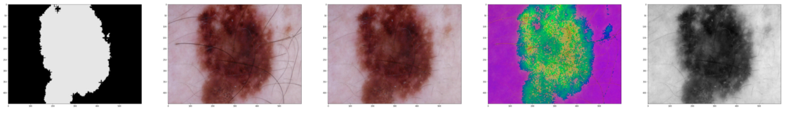
Color Histograms
Calculated individual and multi-dimensional histograms of
RGB
HSV
GrayScale
Individual and multidimensional proved to give almost same results.
Simple but good :inconsistent pigmentation, with varying shades of brown and black (ABCDE of Clinical Diagnosis)

Slide 13
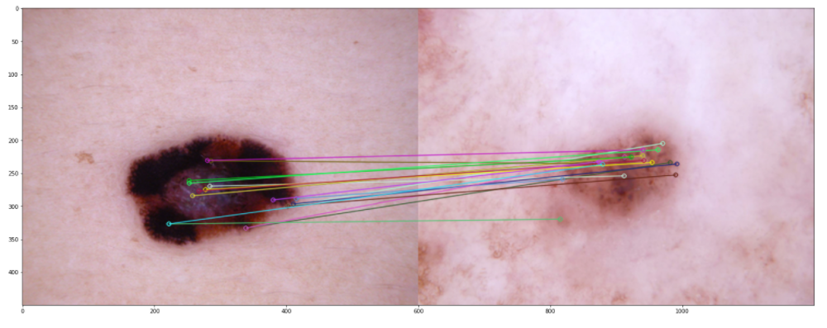
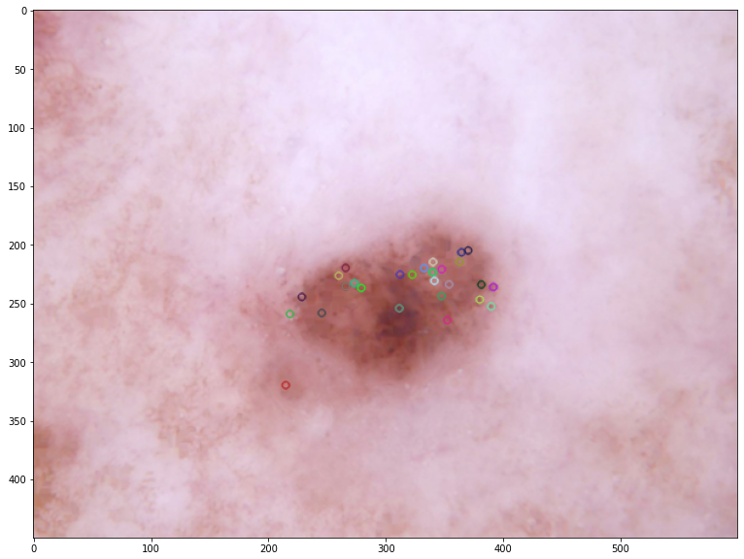
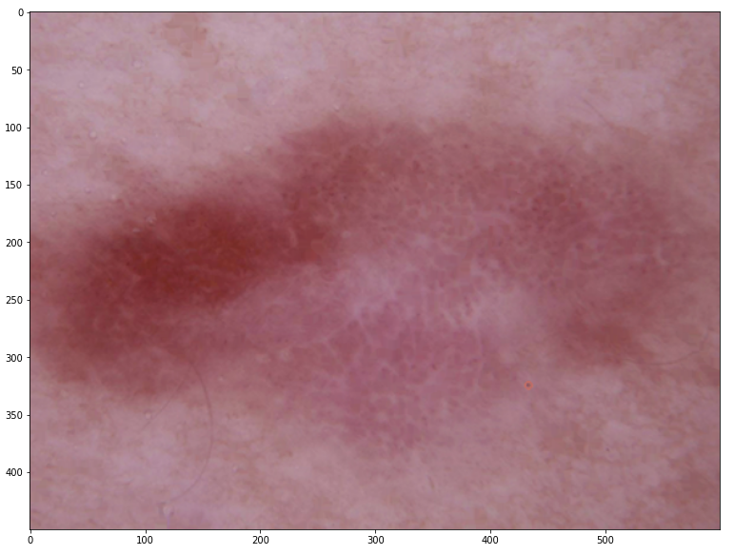
SIFT Features
Local features in an image, commonly known as the 'keypoints'
Keypoints are scale & rotation invariant
For each Keypoint we get a feature vector of 128 size
Then use BOVW on those feature vectors
There can also be images where we find no keypoints or some where we find a lot.

Slide 14
LBP Features
Calculated LBP Histogram of channels of:
RGB
HSV
YCrCb
Images with respect to the original image used

Slide 15
GLCM Features
Calculated information about
dissimilarity
correlation
homogeneity
energy
contrast

Slide 16
Classification
1 Main Algorithms was used for classification and evaluating results with respect to Challenge 1:
SVM

Slide 17
RESULTS P1 - Geometrical Features
Geometrical Features
 | Accuracy Score
SVM | 0.745
RF | 0.739
Asymmetry | NV | LES
X | 0.34 | 0.51
Y | 0.33 | 0.5
Border Irregularity | NV | LES
Area to Parameter ratio | 26.21 | 29.55
Compactness | 0.15 | 0.25
Perimeter x Area [*e-8] | 2.73 | 4.21
Diameter information | NV | LES
Average diameter | 251.71 | 289.41
Diff between principal axes | 137.34 | 173.4
Color | NV | LES
# | 5.48 | 5.85

Slide 18
RESULTS P1
LBP Optimization
LBP without mask | 0.86
LBP with mask | 0.83
Distance = 8 | Variable Radius
2 | 0.86
3 | 0.853
4 | 0.853
Radius = 2 | Variable Distance
4 | 0.855
6 | 0.86
8 | 0.86
10 | 0.851
12 | 0.864
16 | 0.863
Radius = 2 | Distance = 8 | Variable # of Bins
8 | 0.86
10 | 0.87
12 | 0.238
15 | 0.5
Sift Optimization
Sift with mask - Hair removed | 0.499
Sift with mask - With Hair | 0.7225
GLCM Optimization
masked image GrayScale | 0.77
masked image RGB | 0.81
only image GrayScale | 0.7175
only image RGB | 0.8025
Keeping RGB but adding more color spaces
RGB | 0.81
RGB + HSV | 0.829
RGB + HSV + YCrCb | 0.839
Change distance parameter
3 | 0.836
5 | 0.839
8 | 0.838
11 | 0.841
15 | 0.8375

Slide 19
RESULTS P1
Color Histogram 1D
R+G+B+H+S+V+Gray | 0.75
Color Histogram Multi-dimensional
H + S | 0.81
RGB + HSV + Gray | 0.842
Color Moments
RGB | 0.825
RGB + HSV | 0.858
RGB + HSV + YCrCb | 0.87

Slide 20
RESULTS P1 - Combined Features
Geometrical + LBP features | 0.8825
Geometrical + LBP + color moments | 0.878
Geometrical + LBP + SIFT | 0.879
Geometrical + LBP + SIFT + color moments | 0.88
Geom + LBP + histMulti | 0.8125

Slide 21
Classification
2 Main Algorithms were used for classification and evaluating results with respect to Challenge 2:
SVM
RF
For dealing with unbalanced data problem:
Using Synthetic Minority Oversampling Technique, or SMOTE
Random example from minority class chosen
K examples found near it and randomly select a neighbour
New example created from random point between two examples

Slide 22
RESULTS P2 - Geometrical Features
Geometrical Features | Accuracy Score
 | SVM | RF
 | 0.512 | 0.486
smote | 0.492 | 0.486
Asymmetry | BCC | BKL | MEL
X | 0.64 | 0.54 | 0.41
Y | 0.63 | 0.51 | 0.41
Border Irregularity | BCC | BKL | MEL
Area to Parameter ratio | 30.65 | 30.09 | 28.33
Compactness | 0.34 | 0.26 | 0.18
Perimeter x Area [*e-8] | 4.08 | 4.29 | 3.98
Diameter information | BCC | BKL | MEL
Average diameter | 292.5 | 293.98 | 283.17
Diff between principal axes | 186.22 | 179.72 | 163.79
Color | BCC | BKL | MEL
# | 5.76 | 5.88 | 5.92

Slide 23
RESULTS P2 - Other features
GLCM | SVM | RF
 | 0.686 | 0.664
smote | 0.7 | 0.652
LBP | SVM | RF
 | 0.47 | 0.528
smote | 0.482 | 0.53
COLOR MOMENTS | SVM | RF
 | 0.666 | 0.408
smote | 0.654 | 0.3992
Color Histogram Multi-dimensional | SVM | RF
 | 0.654 | 0.716
smote | 0.636 | 0.738

Slide 24
RESULTS P2 - Combined
GLCM + geom | SVM | RF
 | 0.692 | 0.652
smote | 0.694 | 0.648
GLCM + geom + LBP | SVM | RF
 | 0.588 | 0.61
smote | 0.648 | 0.666
GLCM + geom + LBP + color moments | SVM | RF
 | 0.618 | 0.468
smote | 0.65 | 0.544

Slide 25
CONCLUSIONS
Project 1
Final pipeline included using features:
GLCM
Geometrical features
The Classification algorithm used was: SVM
Project 2
Final pipeline included using features:
Multidimensional Color Histogram
The Classification algorithm used was: Random Forest

Slide 26
Future Work
Improving Segmentation
Optimization of features such as LBP, GLCM, SIFT with respect Project 2
Using different Machine Learning algorithms and more in-debth optimization

